Slide 1
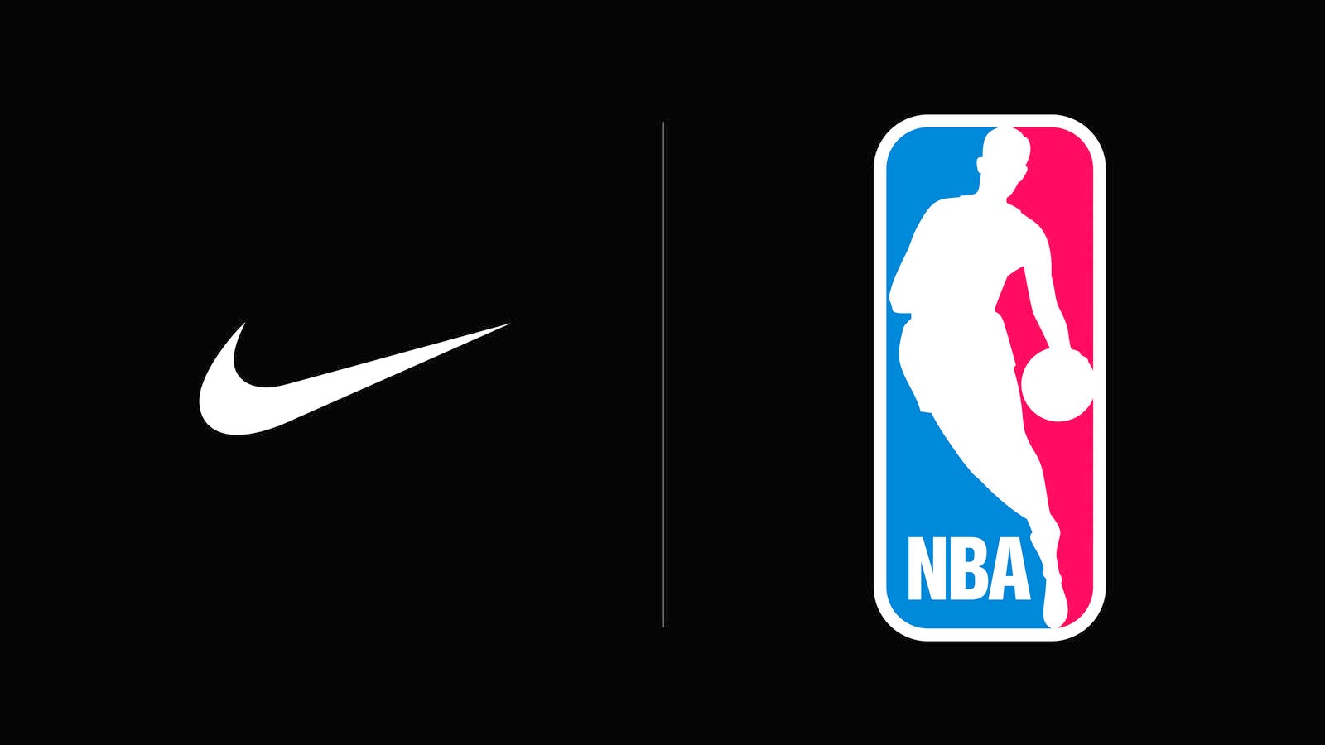
Tweet Analysis
By Jack Daoud

Slide 2



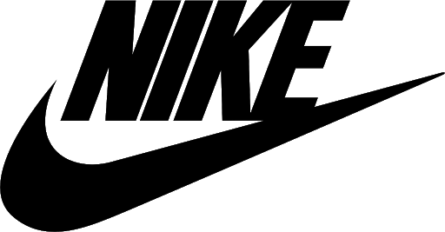


How has Nike’s brand performed compared to competitors during the 2019-20 NBA Season?

Slide 3
Outline
Data Overview
Text Data
Processing
Findings
Recommendations

Slide 4

Data Overview
5.2 M tweets for the 2019-20 NBA Season
SRS of 1%
52,000 tweets
4 variables:
Unique ID
Text
Timestamp
Team
Data Overview

Slide 5
Feature Engineering
`Year`
`Month`
`Day of Week`
`Hour’
`Timestamp`
Data Overview

Slide 6
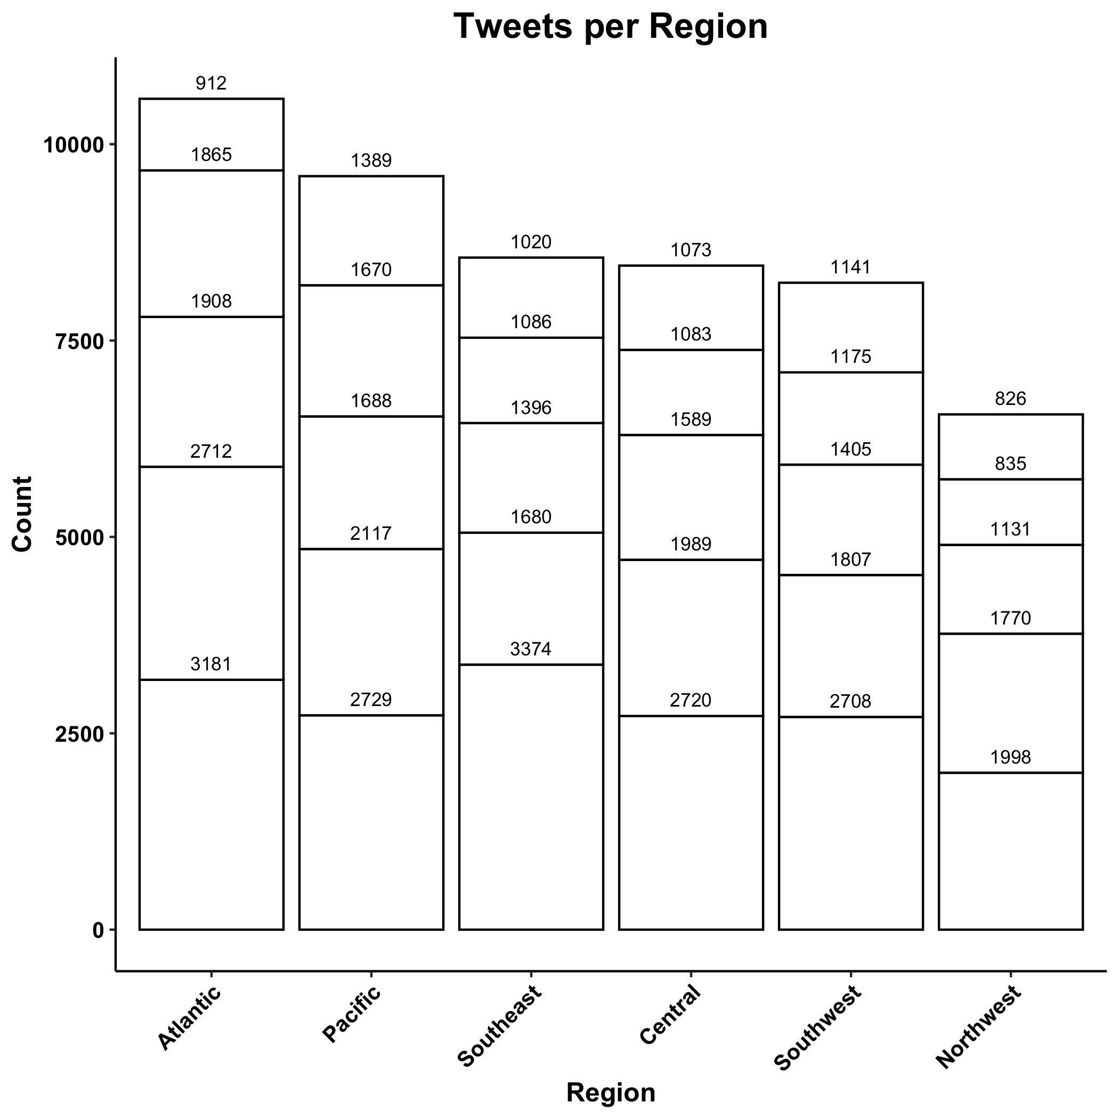


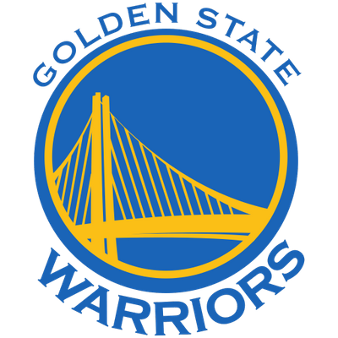

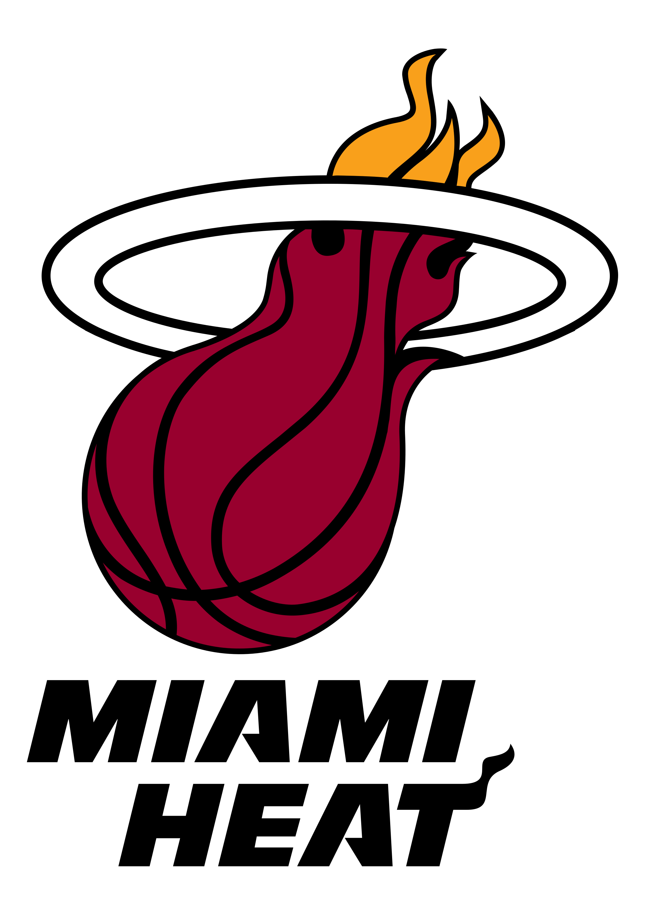





Total Tweets per Region
Top 5 Teams by # of Tweets:
Miami Heat
Boston Celtics
LA Lakers
Chicago Bulls
Toronto Raptors
3374
3181
2729
2720
2712
Data Overview

Slide 7
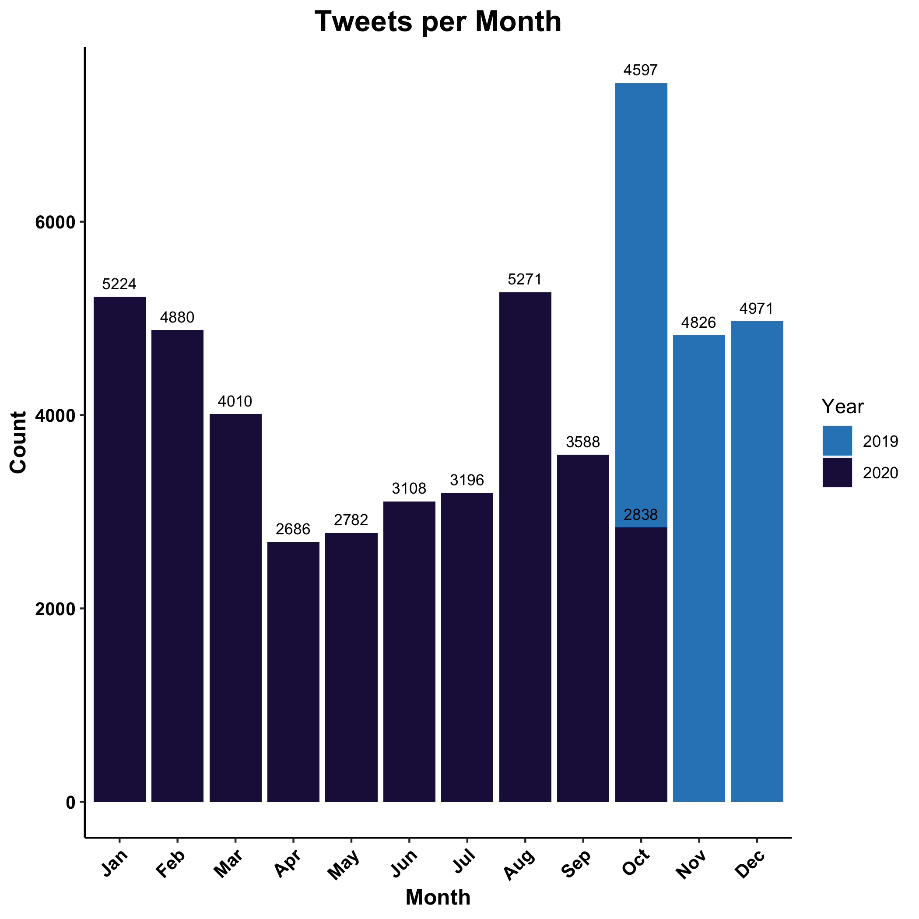

Total Tweets per Month
Season suspended due to COVID-19
Players’ strike
Longest season in NBA history
Season suspended on March 11, 2020 due to COVID-19
Season restarted on July 31, 2020
Players strike on August 26, 2020 to protest the police shooting of Jacob Blake
Season restarted
Data Overview

Slide 8



Text Data Processing
RT @DadJokes: Why don't eggs 🥚 tell jokes? They'd crack each other up! 😂
Remove URLs, RT, Usernames, & Emojis
Remove Punctuation
Make Lower Case
Remove Numbers
Remove Stop Words (~ 1,000 words)
eggs jokes crack
Data Processing

Slide 9

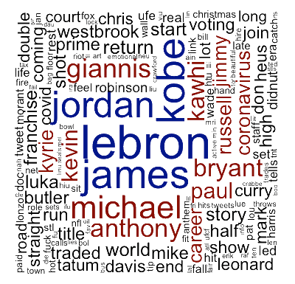
Text Mining Approach: Bag of Words
Data Processing

Slide 10
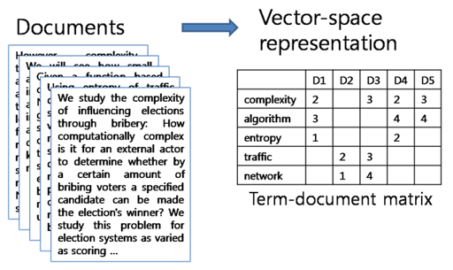
Data Processing

Slide 12
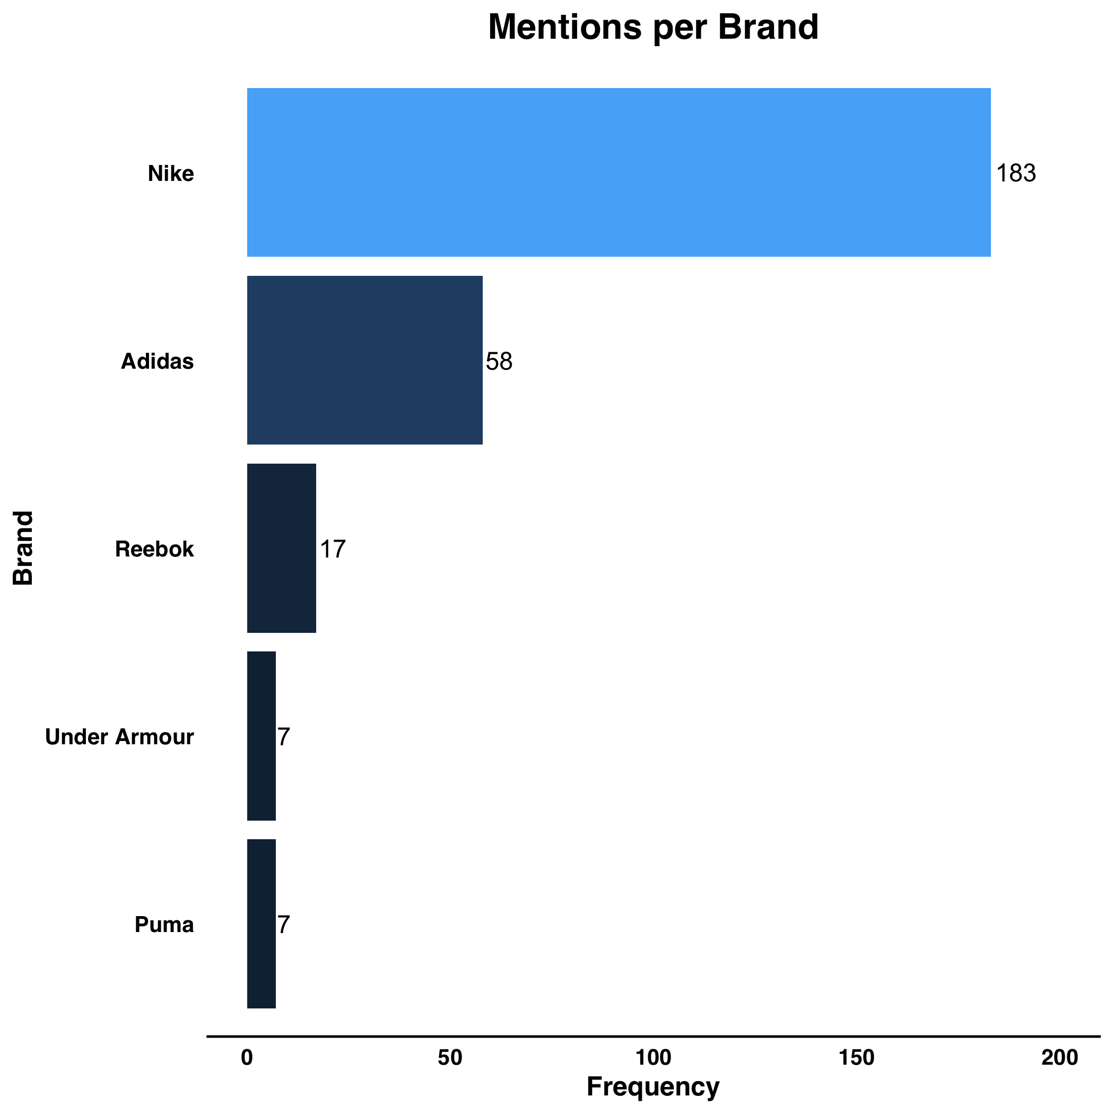
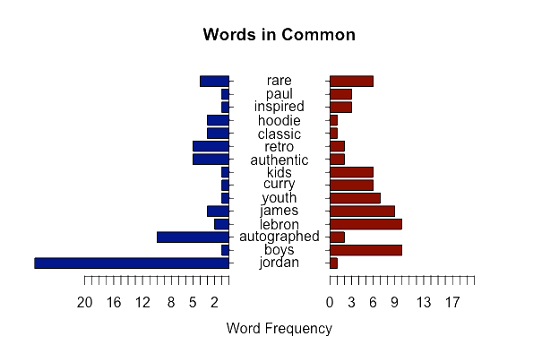


Frequencies
Findings

Slide 13
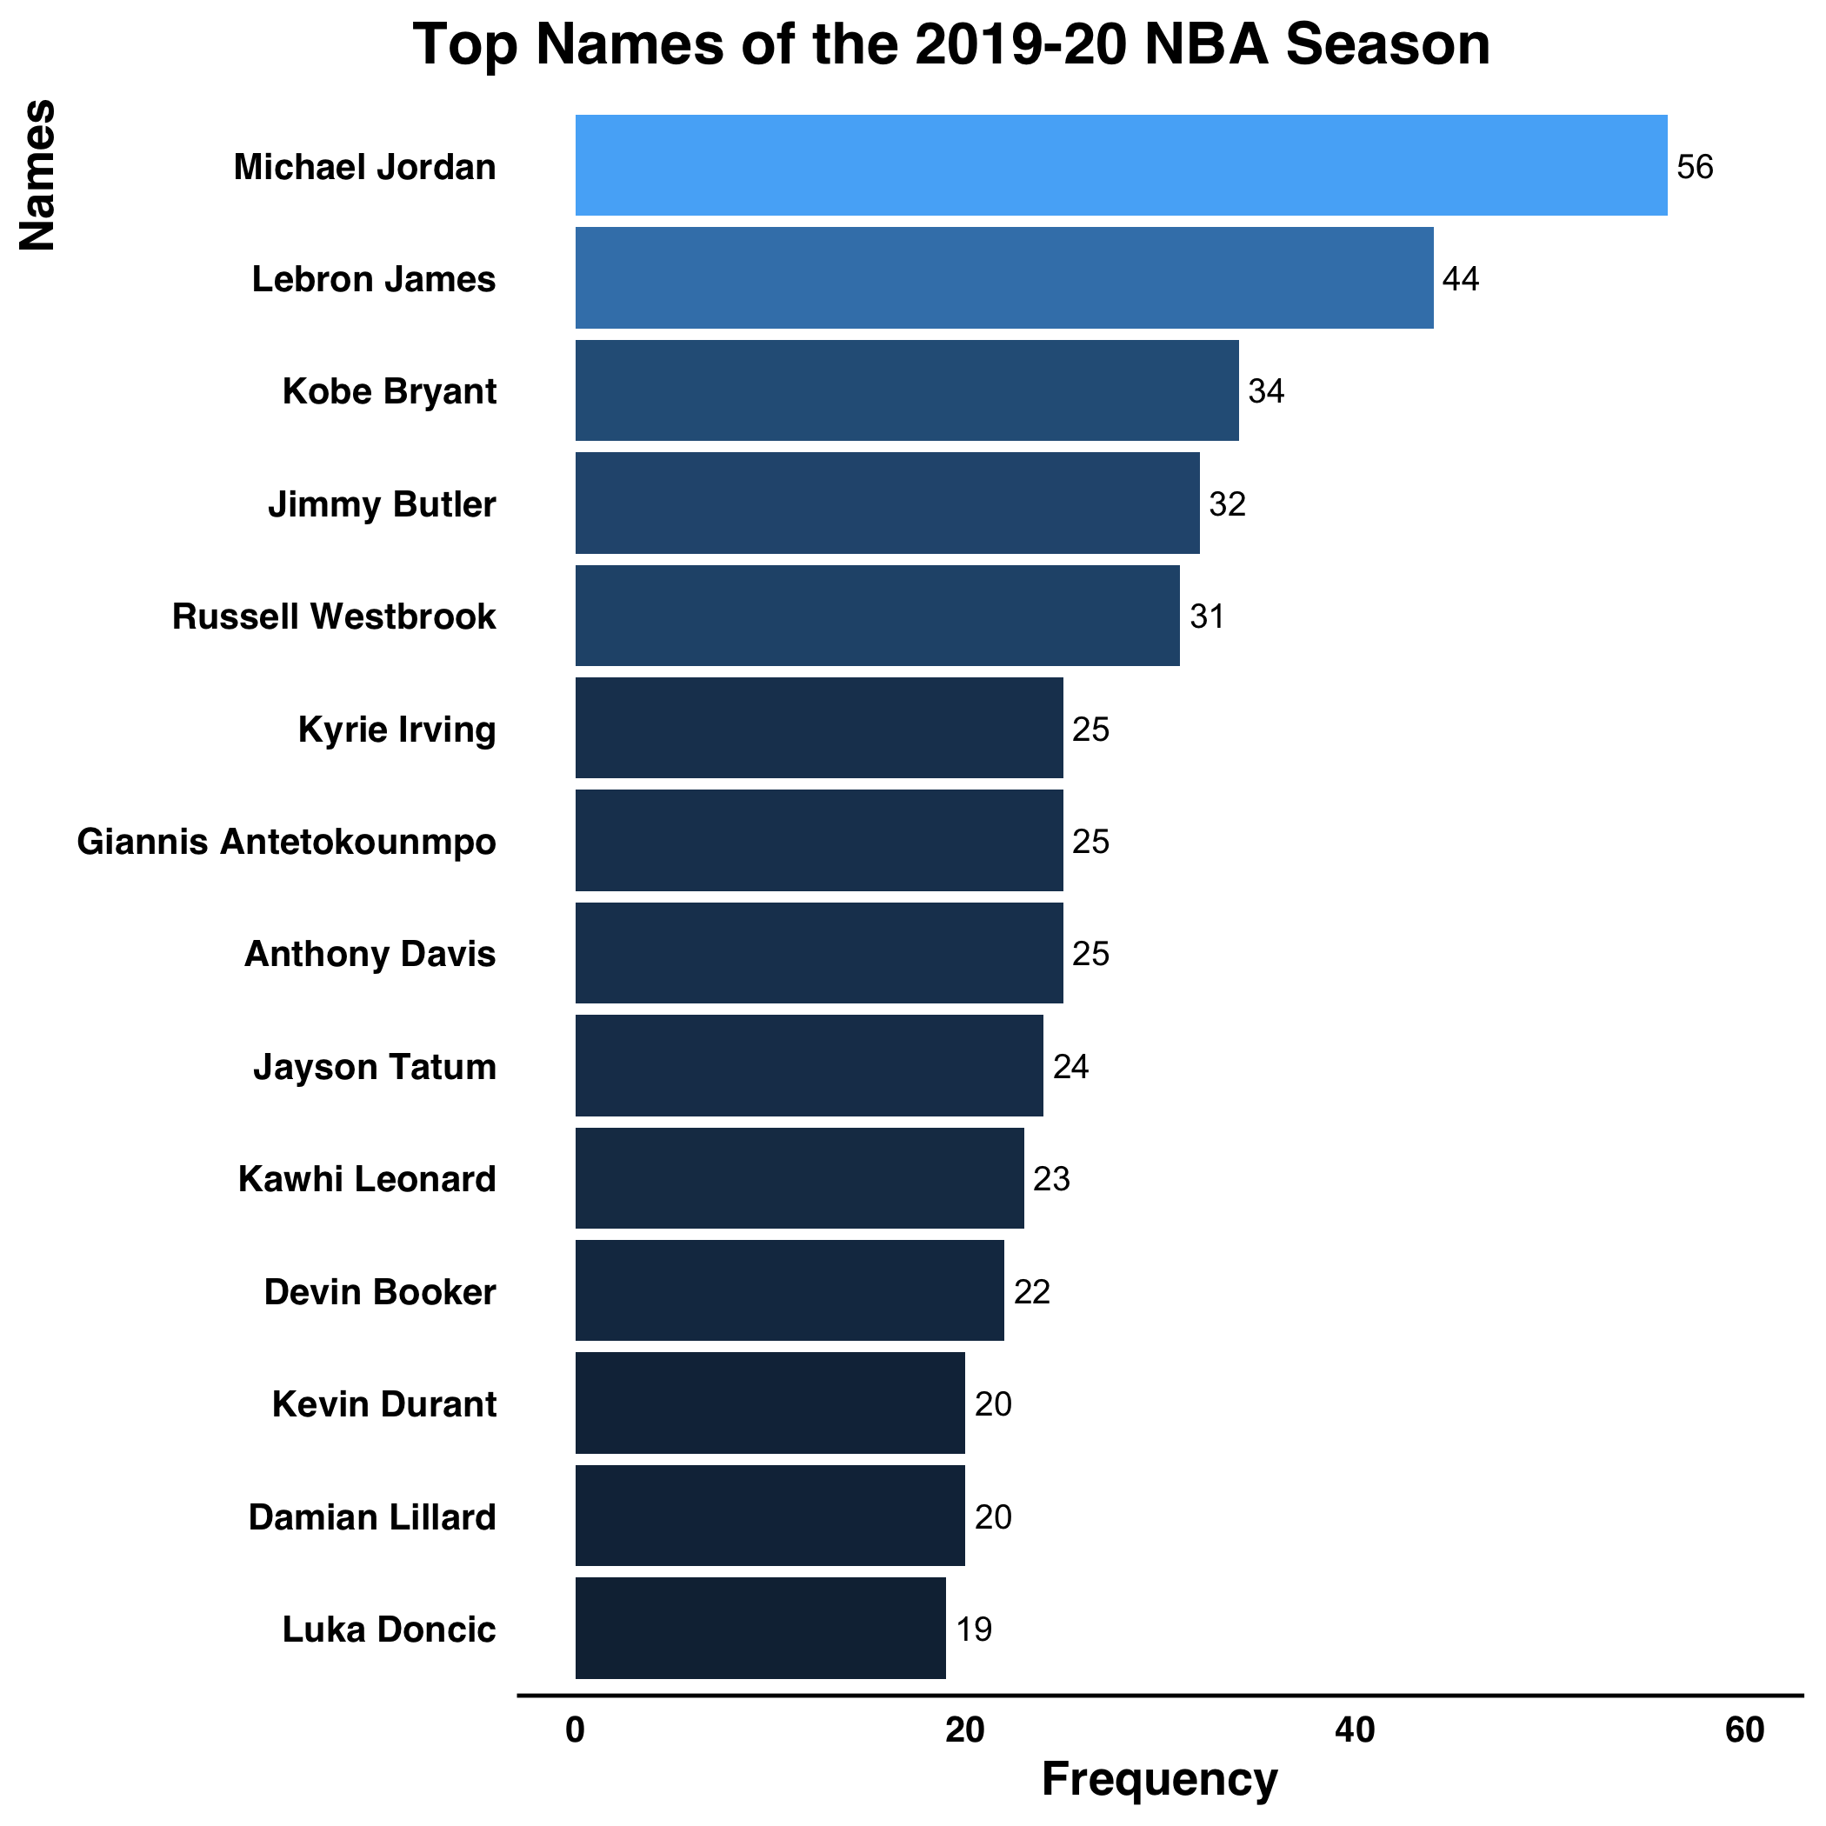
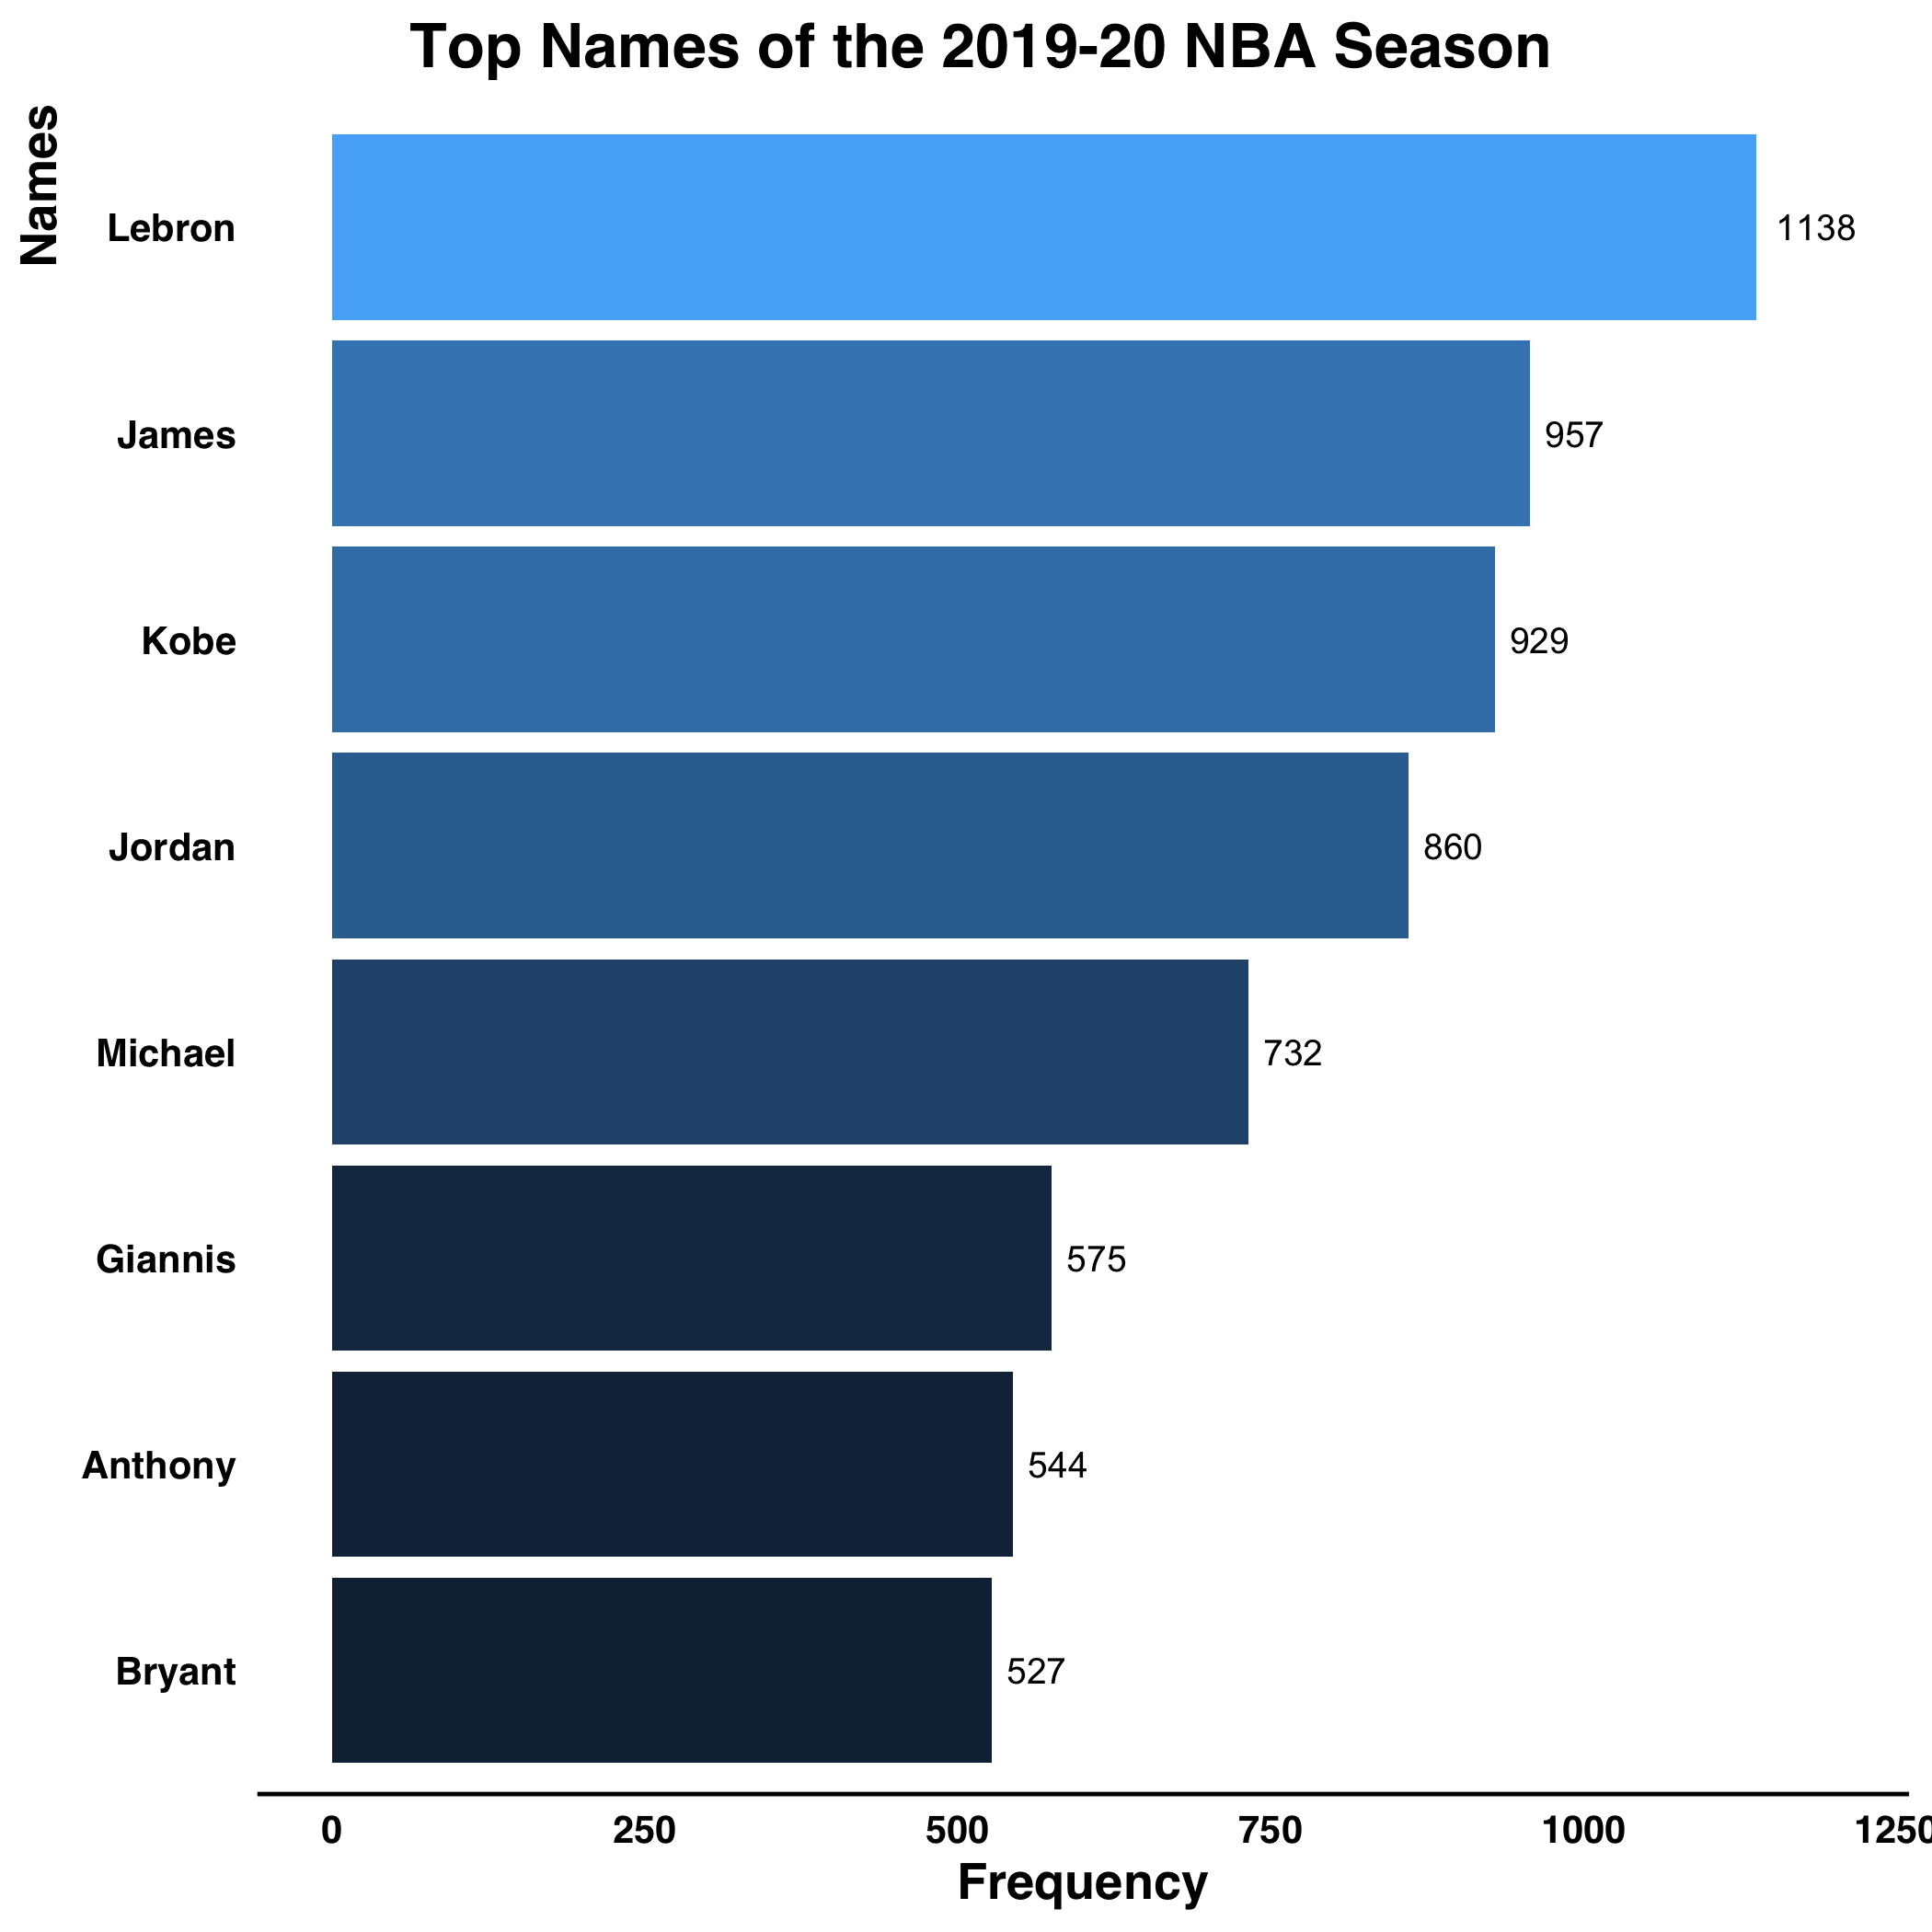
Sponsored Players
52,000 tweets
SRS of 10%
5,200 tweets
Findings

Slide 14
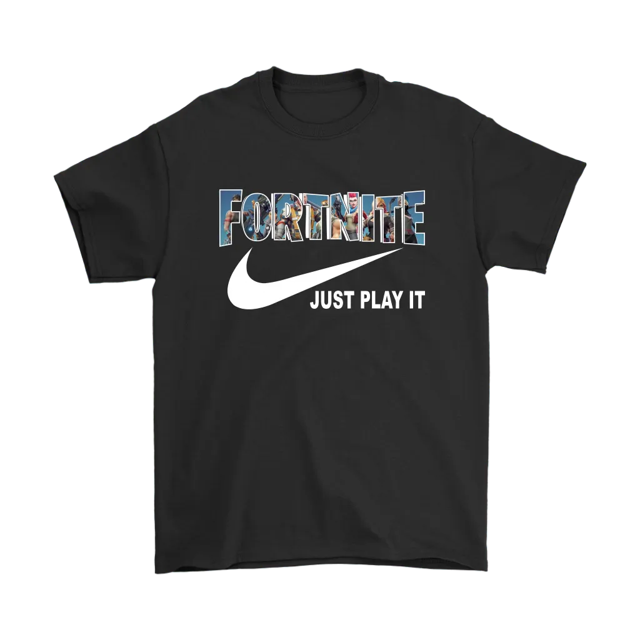
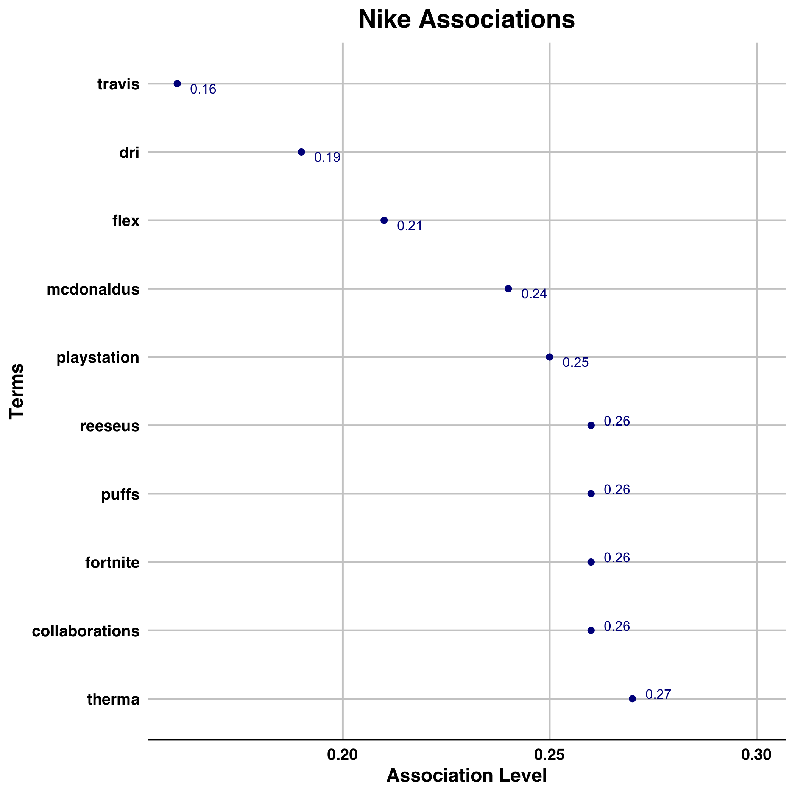
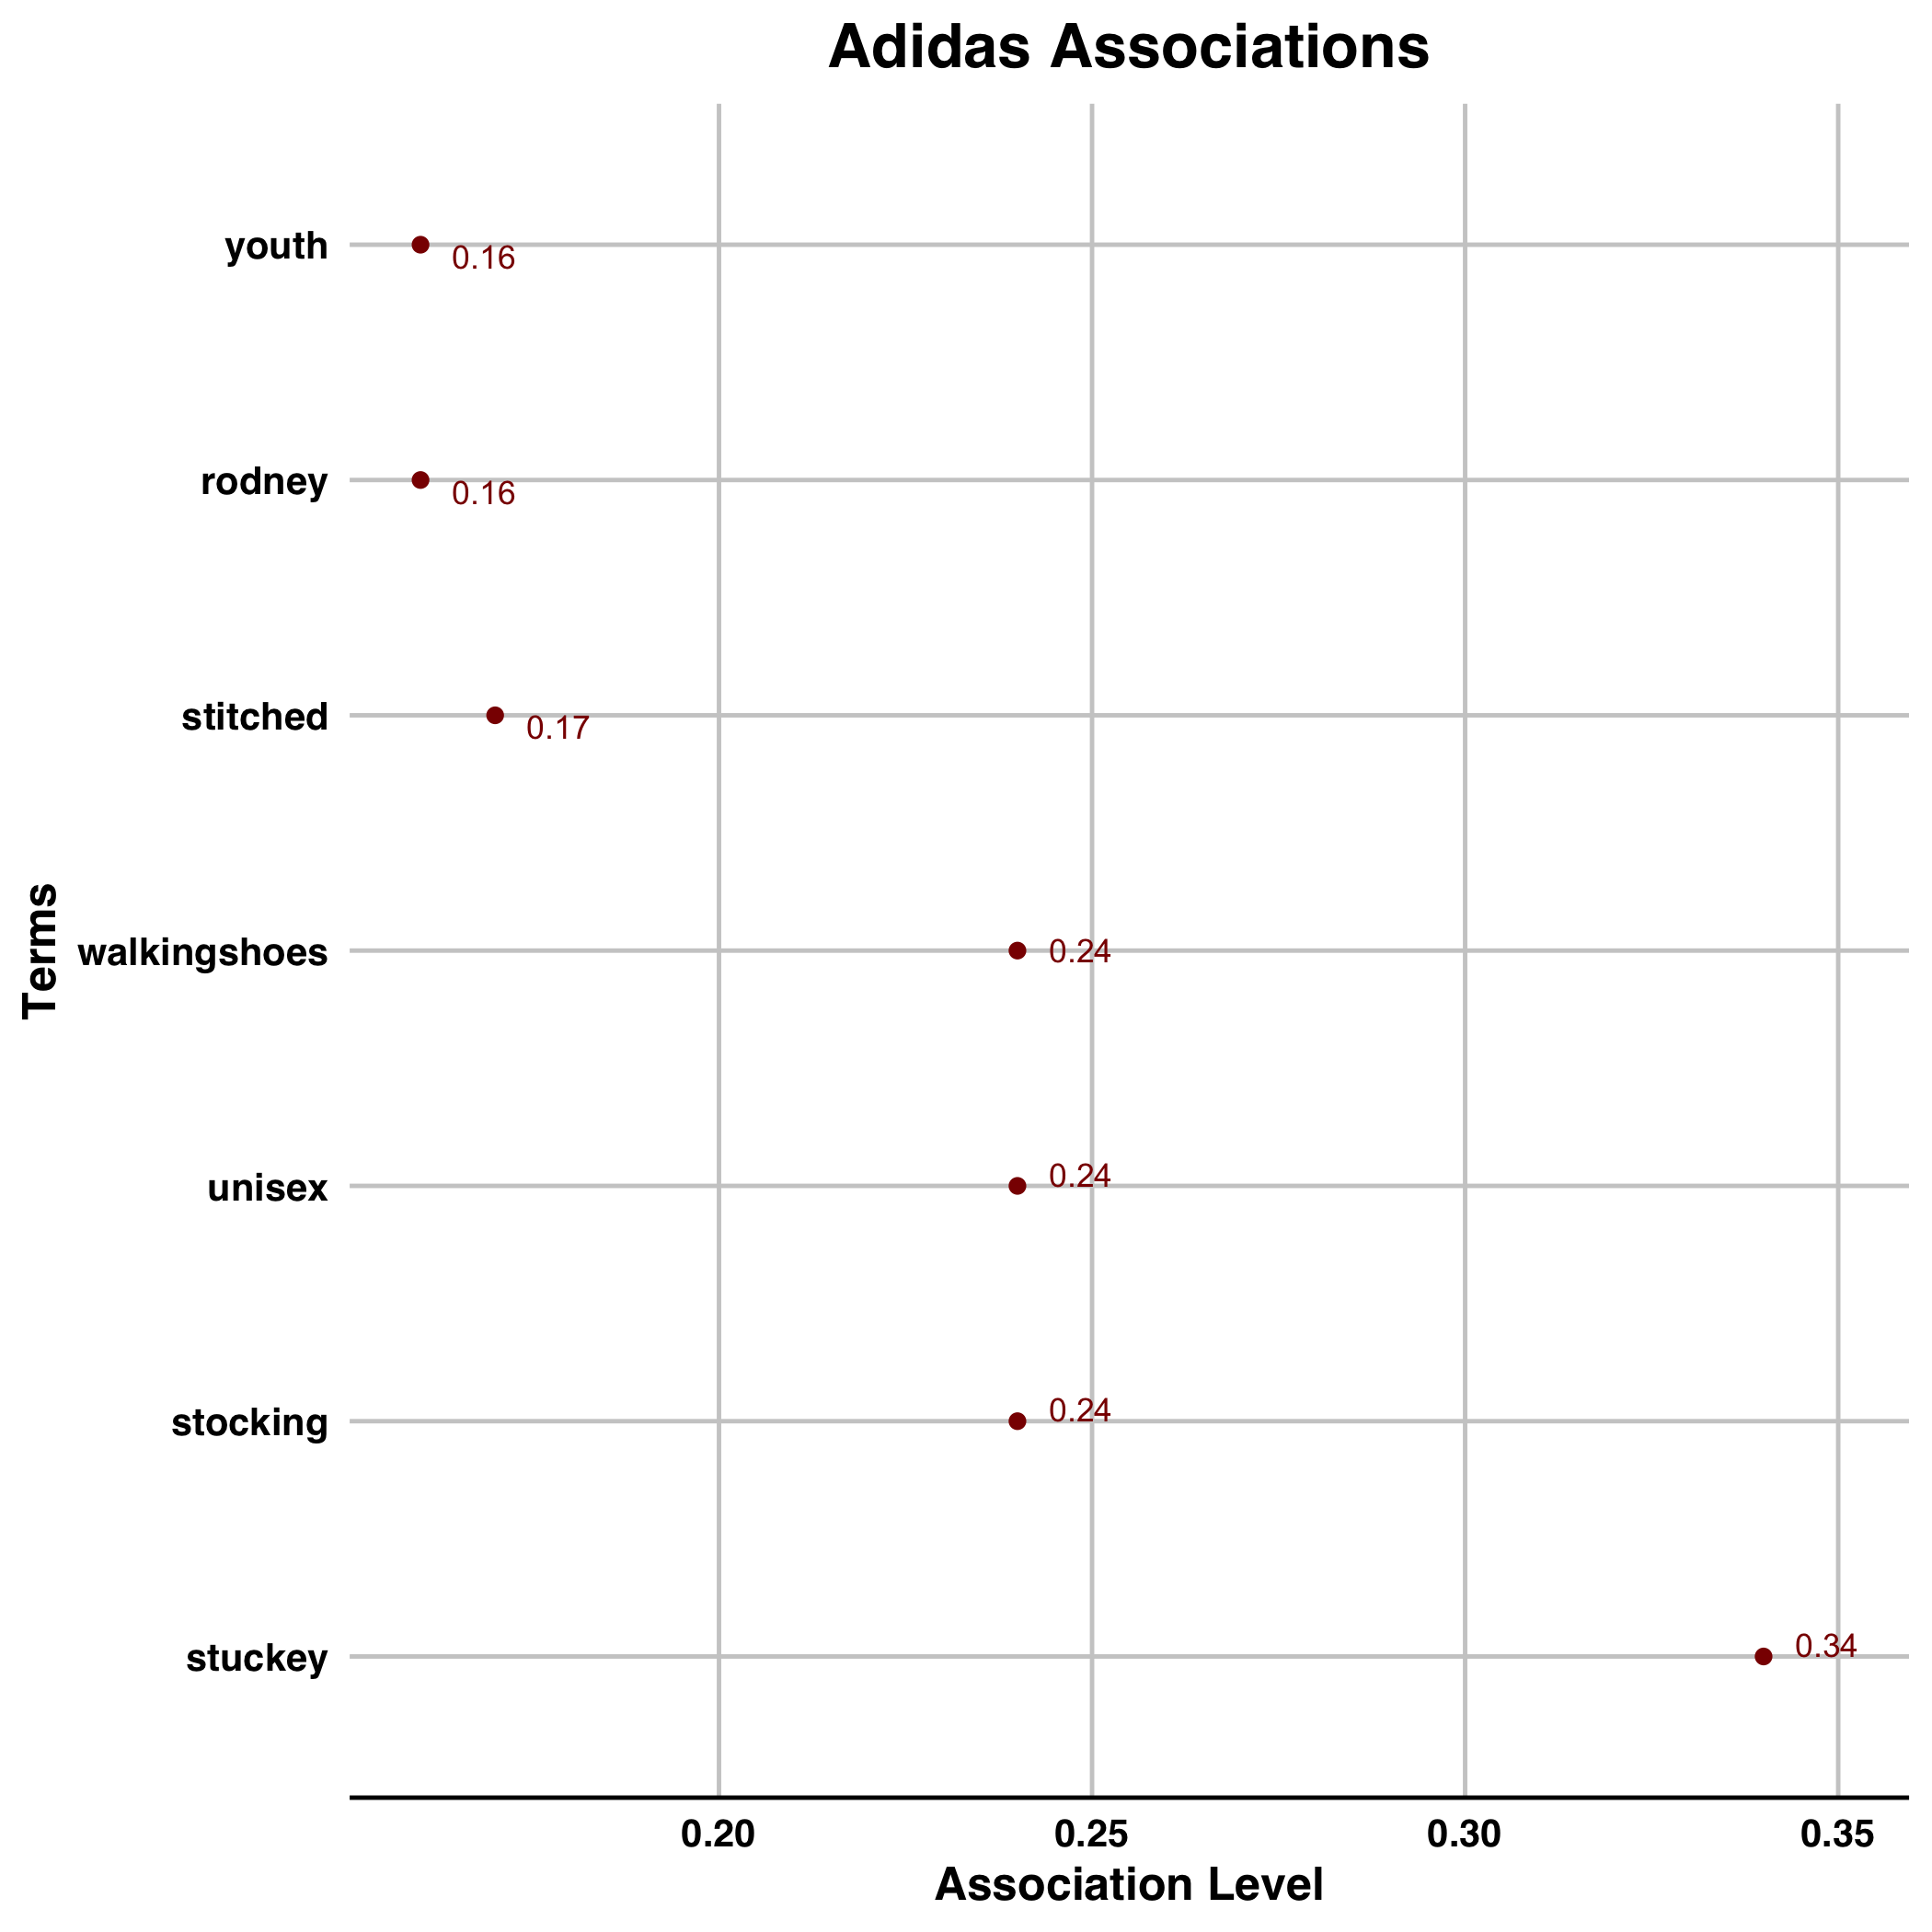
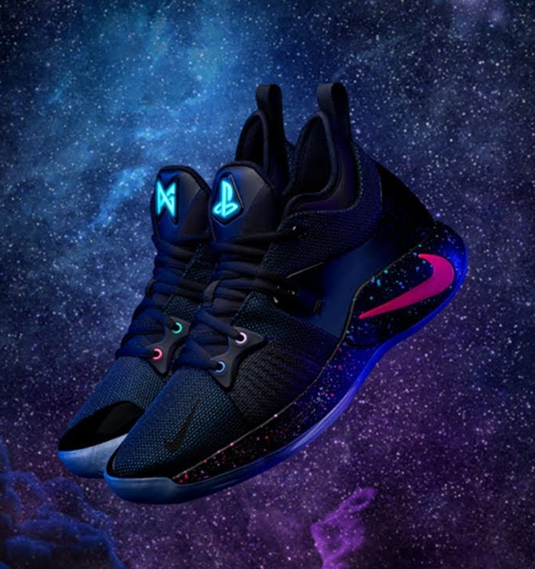
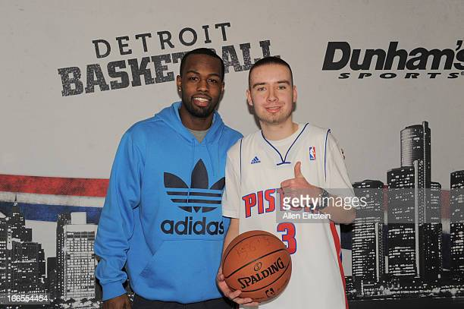
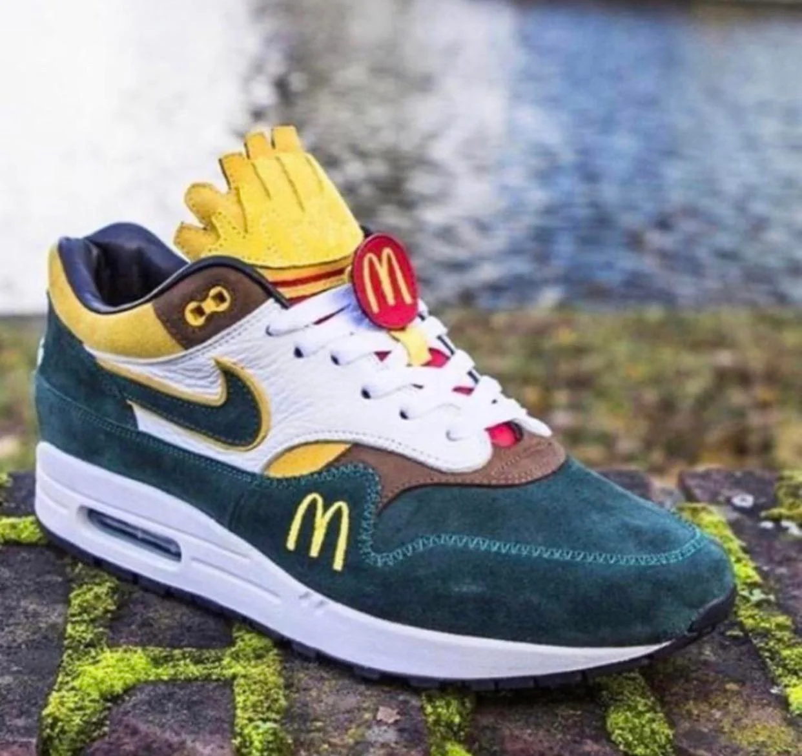
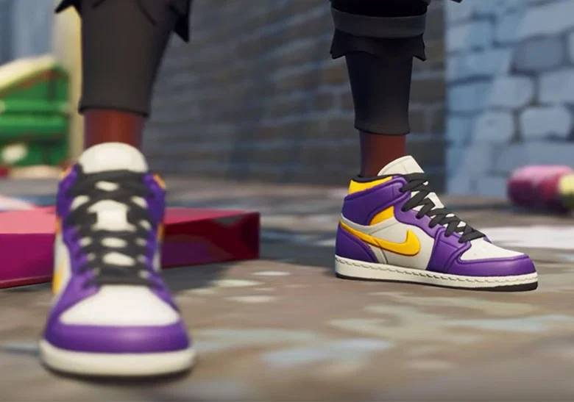
Associations
Findings

Slide 15




Recommendations
Target a younger demographic with products highly associated with Nike (e.g. PlayStation)
Increase advertisement & awareness of Gender Neutral product line
Increase fan engagement with NBA players sponsored by Nike through meetups & events

Slide 17
Thank you

